Slide 1
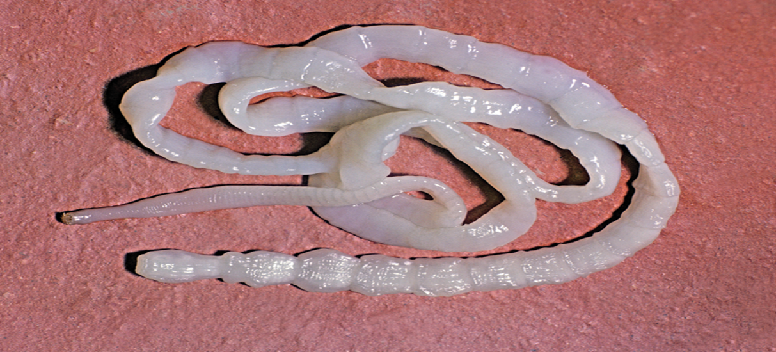
Tapeworm (Taenia spp)

Slide 2
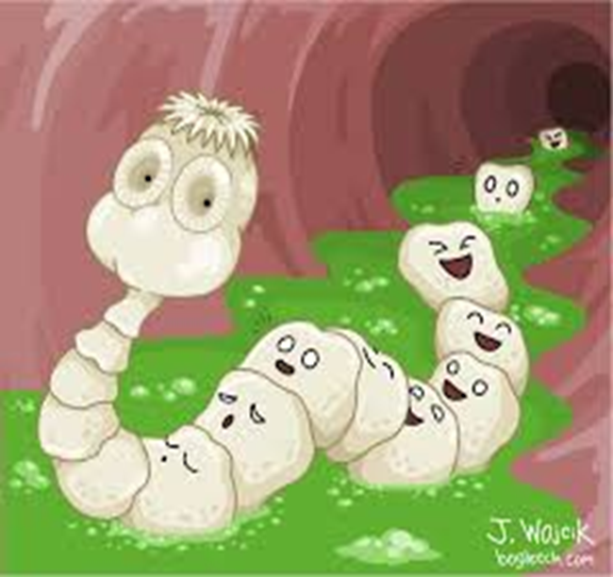
Taxonomy
Kingdom : Animalia
Phylum :Platyhelminthes
Class: Cestoda
Order: Cyclophyllidea
Family: Taeniidae
Genus- Taenia
Species :T.saginata
& T. solium.

Slide 3
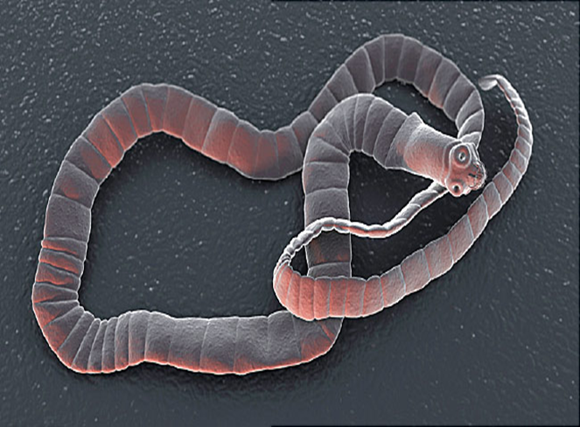
General characteristics
1- The Cestodes (tapeworms): Adult worm is
flattened ribbon-like, without body cavity.
2-Cuticle of the body is provided with pores
through which the worm takes its nutrients
(no digestive system).
3-The body is composed of a head, neck and
segmented strobilus.
4-The head (scolex) : Is the organ of attachment and provided with muscular suckers and crown of hooks (rostellum) to attach to intestinal wall suckers ,Rostellum and hooks may be present in some species.
5. The neck is the budding zone from which segments are formed.

Slide 4
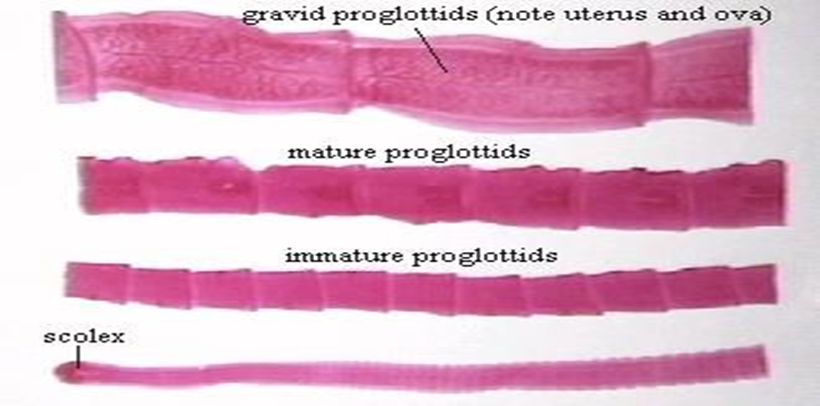
General characteristics
6-Strobilla: the long segmented body consists of segments which are of three types
The immature segments which follow the neck region
The mature segments containing both sex organs and
are responsible for reproduction
The gravid segments filled with fertilized eggs.

Slide 5
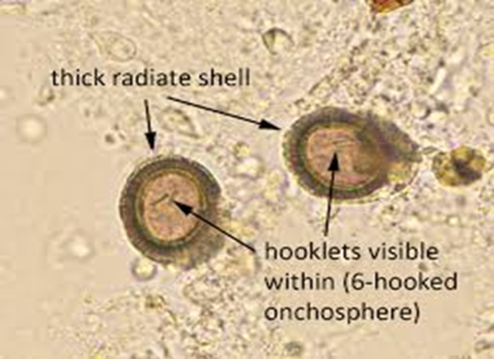
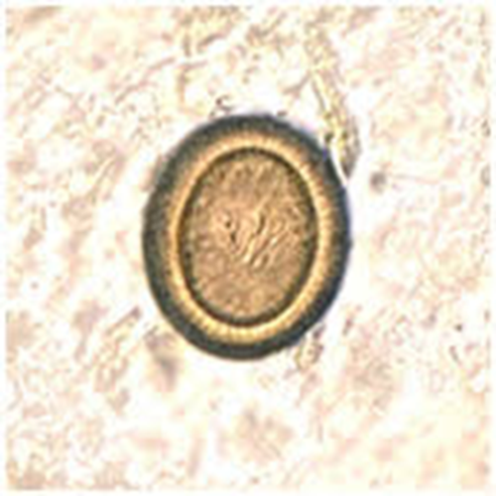
General characteristics
7- Cestodes are hermaphroditic worms, each mature segment possesses both male and female sex organs.
8- Eggs It is rounded in shape and consists of hexacanth embryo(3 pairs of hooks) called (onchosphere).

Slide 6
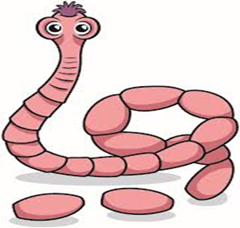
9. Taeniasis are important zoonotic disease caused by Taenia saginata and Taenia solium. They are found in intestine of human host

Slide 7
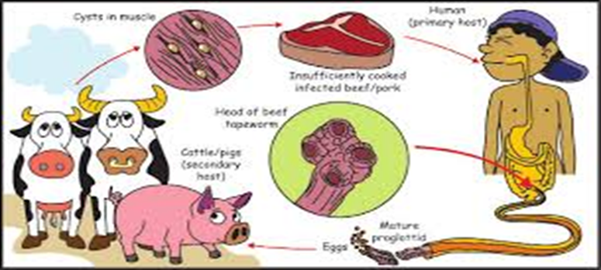
10. These parasites have an indirect life cycle, cycling between a adult in the definitive host (human) and larval in the intermediate host (cattle or pig).

Slide 8
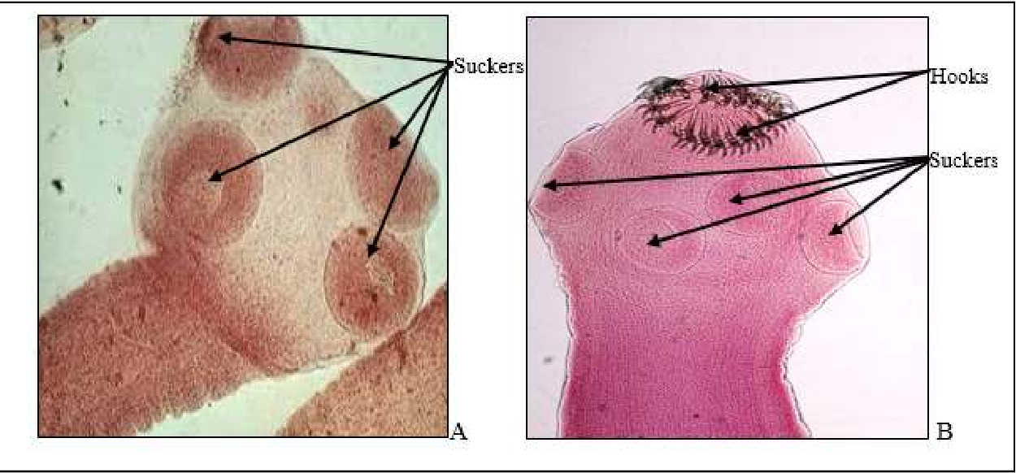
Type of tapeworm
The most common types of tapeworm infections in humans are: -
1.Pork tapeworm (Taenia solium)
2.Beef tapeworm (Taenia saginata)

Slide 9
Taenia saginata
It is an intestinal parasite of human and cattle , Infection is due to ingestion of infective larvae. It is commonly known as the beef tapeworm or cattle tapeworm. It is a large tapewormthe length of it about 5-10 meters, The adult has a head Scolex are large , absence of rostellum and hooks and It has four muscular suckers

Slide 10
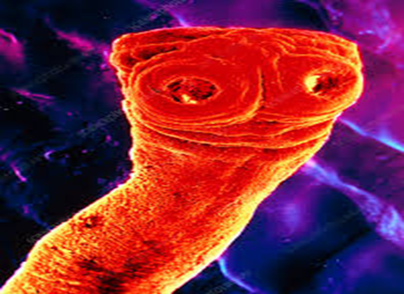
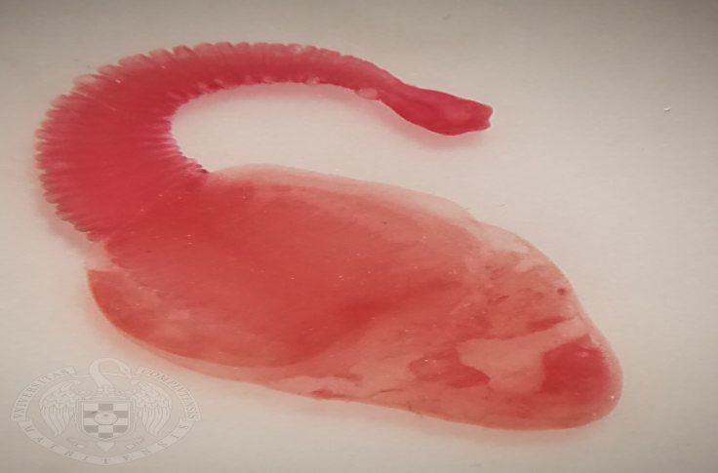
Larval stage
The larval stage of T. saginata is Cysticercus bovis ,Consist of a fluid filled sac or bladder containing a small invaginated scolex which has suckers but no hooks.

Slide 11
Taenia solium
A tapeworm that is parasitic in humans and is acquired by eating infected pork that isinsufficiently cooked. The adult has a head (scolex) that consists of four suckers and a rostellum with a double crown of hook , The Adult T.solium measures 2-6 metres in length

Slide 12
Larval stage
Larva of T.solium called cysticercus cellulose . It is consist of a pea-sized fluid-filled bladder with an invaginated scolex.
Cysticercosis : is an infection of both humans and pigs with the larval stages of T. solium. This infection is caused by ingestion of eggs shed in the feces of a human tapeworm carrier

Slide 13
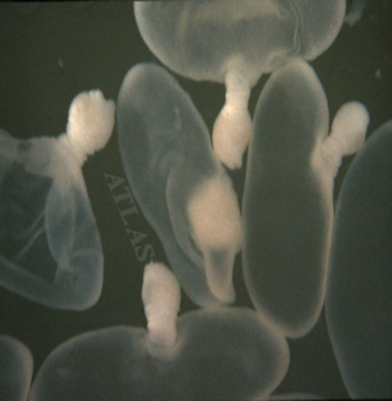
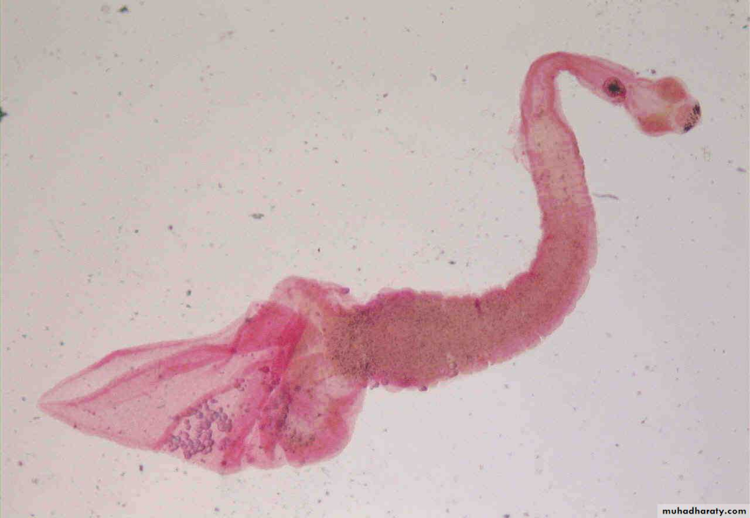

Slide 14
Laboratory diagnosis of Taeniasis
1- Stool examination in this exam show Eggs and Proglottids
2- Species identification based on proglattid morphology
3-Scolex identification
4- Molecular methods Done by PCR
5- X-RAY calcified cysticercus can be detected

Slide 15
Differences between T. saginata and T. solium
T. solium | T. saginata | Charactersitic
2-6 meters | 5-10 meters | Length
rostellum with hook | No rostellum and hook | Scolex
egg and cysticercus | cysticercus | Infective stage
pig | cattle | Intermediate host
cysticercus and adult | cysticercus | Pathogenic stage
Brain, skin, muscle | Muscle, viscera | Site of Development

